Slide 1

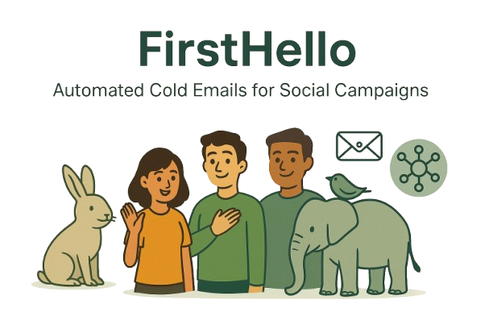
07/07/2025
FirstHello
Cold Outreach Automator
Helping activists send the Right message — to the Right people — at the Right time.
1
JEET
2
PALAK
3
SHUBHAM
4
MANDIRA
5
SARADA

Slide 2
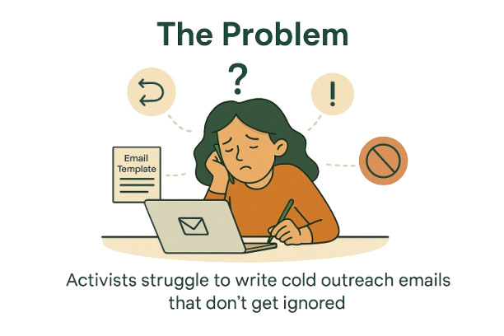
The Problem
Cold Emails for Good Causes Often Fail to Reach the Right People
Writing effective, personalized outreach emails is time-consuming and intimidating
Activists lack tools to find the right contacts in big companies
Most AI email tools are generic, salesy, and not suitable for humanitarian campaigns
There's no system that deeply understands the emotion, purpose, and target of social impact work

Slide 3
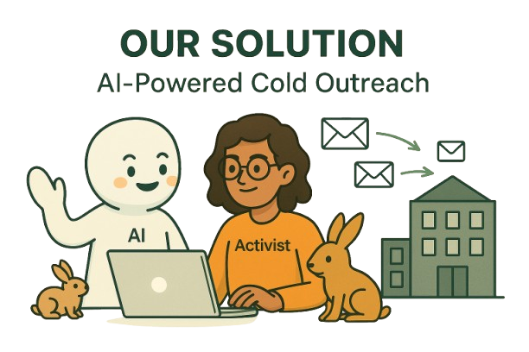
The Solution
Meet FirstHello — Your Outreach Wingperson for Social Change
Input Campaign
Smart Contact Discovery
Personalized Email Generation
Returns 3 Unique Drafts
Syncs to Gmail or Copy-Paste
AI meets activism
Name, goal, target company, industry
Auto-finds real decision-makers from CSR, ESG, PR
Each email with tailored contact, role, and tone
powered by empathy, not marketing buzzwords.
Warm, human, cause-aligned language
Ready to send in seconds

Slide 4
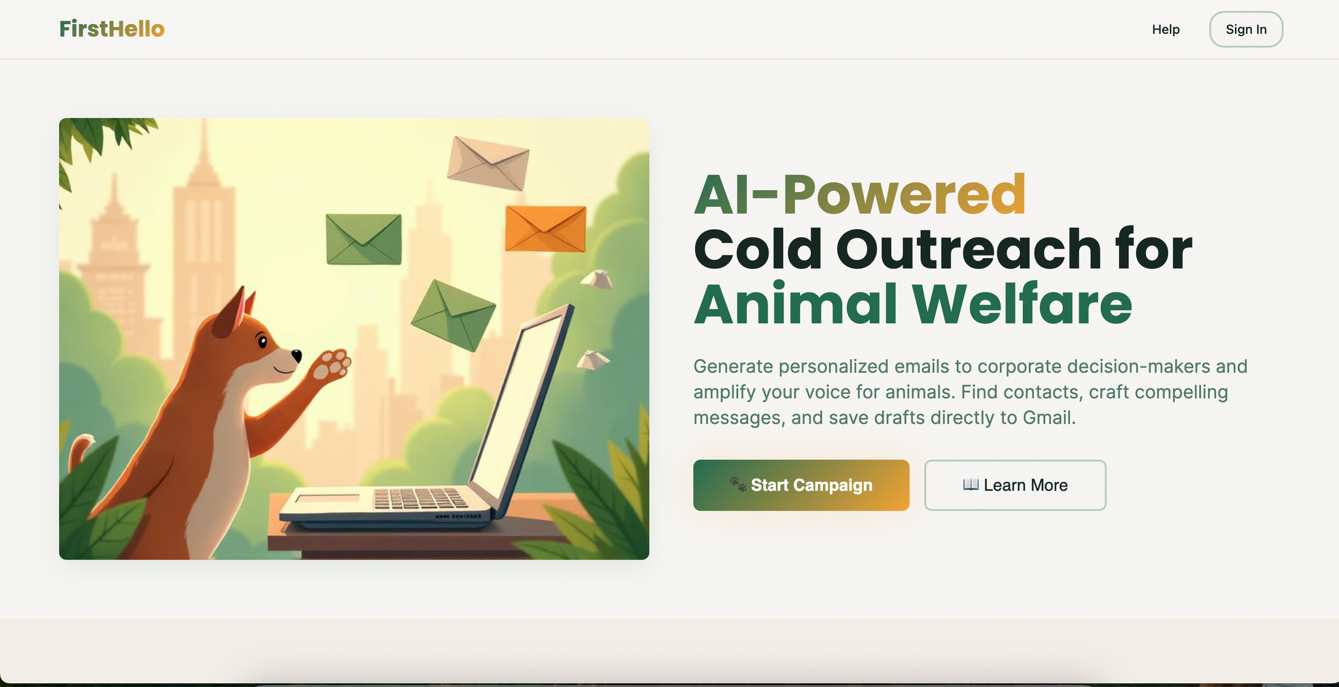
Demo

Slide 5
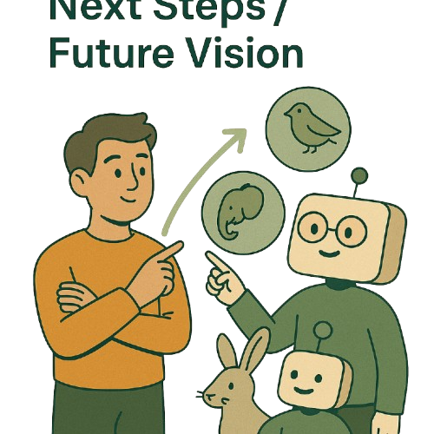
Next Steps Future Vision
From Cold Emails to Global Outreach Infrastructure
Future Work:
🌍 Activist CRM with timeline of outreach
💬 WhatsApp + LinkedIn message formats
🧠 Plug-in for existing activist orgs (NGOs, student groups)
🎤 Voice-based outreach assistant
Short-Term Goals:
✅ Better company contact database (LinkedIn, Twitter, websites)
✅ Output UI polish (email cards, tag-based filters)
🔄 Feedback + A/B Testing to improve tone + open rate
🔐 Add “Verified Email” & delivery insights

Slide 6

Thank You
For Your Attention

